Slide 1
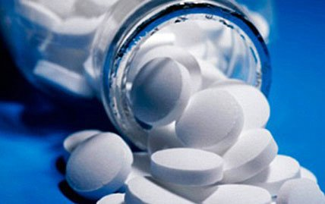
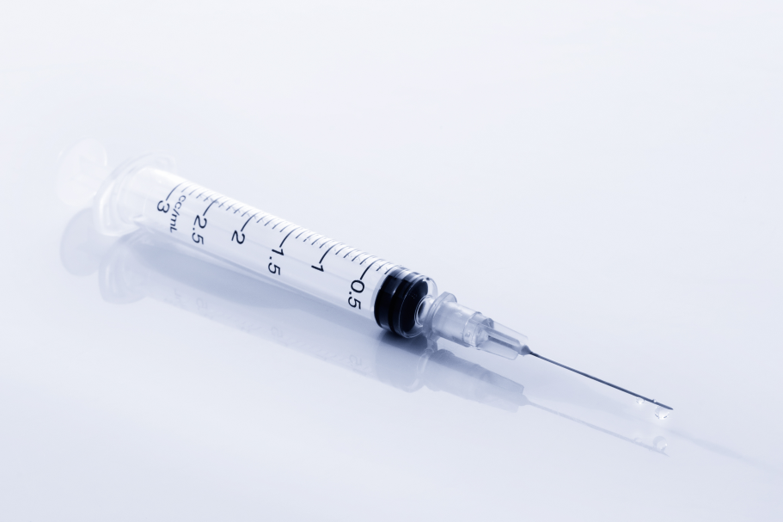
What if I were to make you take these?
EPQ Candidate 1
Notes:
Okay, I’m going on the assumption that the audience is in pretty good health right now. Raise your hand if you are in any physical pain at this time. (Ah how unfortunate, Ok, excluding you). Ok, nobody’s in pain. So how many of you would be willing to take the pain medication I’ve put up. All of it.
Ok, how many people would sit there right now and watch me take all the pain medication? (Ok it seems I’ve already bored some of you to the point where you’d rather I die than continue :’( ...Anyway) Any one of us here could take the medication, because they are placebos. This begs the question of what exactly a placebo is.

Slide 2
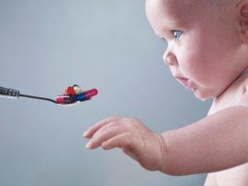
Placebos
Medically inactive treatments
Inert pharmaceuticals
Sham Surgeries
Can improve symptoms, not condition
Notes:
A placebo is a medically inactive treatment. This could be a substance or a procedure that has no active effects that would improve an illness. A pill such as a sugar tablet that wouldn’t interact inside your body to fight your condition. A surgical procedure, where you would go through the process of being cut and sewn back up . So why would such things even exist? It is because they improve your symptoms. Note how I say symptoms and not your actual illness. If a symptom of your illness happened to be pain, they could cause your pain to be relieved. This begs the question of

Slide 3
HOW
Notes:
How? How can a placebo improve your symptoms if it is medically inactive?

Slide 4
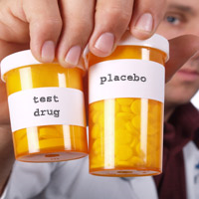
Placebo Response/Effect
Perceived physical and mental responses of the body after a treatment has been administered.
Caused by expectation & ‘conditioning effect’
Nocebo response/effect
Notes:
The answer, ladies and gentlemen, lies within the placebo response. And that begs the question of... What is the placebo effect?
It is a psychological wonder. The placebo effect is what you believe it to be. If somebody experiencing depression believes they have recovered – as a result placebo pill described as an anti-depressant – that is a placebo response. If somebody experiencing pain believes it has improved because of a magic saying or a ritualistic prayer session – both of which have no physical effects on the body – that is a placebo response. I could go on, but I think we’ve gathered it is a response to a placebo.
The placebo effect depends upon some factors that determine how strong the response will be. The expectation of a response will increase the chances of experiencing a response. If you are expecting a reduction in your pain after taking a placebo, you will experience one. It’s a case of if you look hard enough for something, you will find it. If a pill looks really strong, you will be expecting a really strong effect and so you will receive one. The other way in which a placebo response can occur is through past experience. If you believed taking a paracetamol would REALLY cure your depression, and you found that it did, when you next take a paracetamol because you feel depressed, it can make you feel better. I hope we all know that paracetamol will NOT cure depression. The successful past experience can cause you to EXPECT a recovery and so you will feel you have recovered. When you have a personal experience of successful recovery, that continues to work for you, it is called the conditioning effect.
Many of my friends find this to be an amusing term, very original – the nocebo response. If a placebo can have a positive response and aid symptoms it can also work in reverse. Expecting negative responses or being negatively conditioned (where you’ve had bad experiences with treatment in the past) can cause a worsening in your symptoms or even cause some deadly side effects to rise. The worst of which I’m assuming would be death, as this actually happens to be a side effect of some medication. I don't know whether I should advise you to read the label, so it can prevent you taking medication with side effects such as death or whether I should tell you to avoid the label as you may start expecting death the next time you take cough syrup causing the nocebo effect to kick in.

Slide 5
AT THIS POINT

Slide 6
Where are we on our journey to finding the extent to which placebos are an effective treatment for pain?
What is a placebo?
How does it work?
How placebos work for pain & whether they are effective.
Notes:
The purpose of the presentation is to find whether placebos can be effective treatments for pain. Now that we know what placebos are and how the work, we can move on to look at how the work for pain and whether they’re any good.

Slide 7
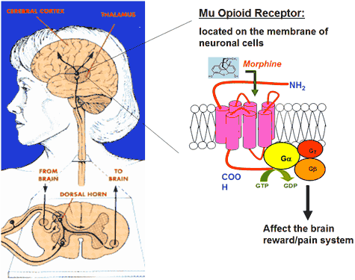
PLACEBO ANALGESIA
Notes:
Placebo analgesia is the pain relief caused by placebos. But how can we just believe this claim? Because there is proof. A medical study used a technique to monitor the brain after a patient had received a placebo. This technique was fMRI. Functional Magnetic Resonance Imaging. Similar principal to MRI, but detects brain activity. The area of the brain which had been activated all contained Mu opioid receptors. If any of you have done maths and the stats module – its the same type of mu. These receptors are present in nerve cells and as shown in the diagram it is affected by morphine. Morphine is a type of opiate. Heroin and poppy seeds contain opiates. They all affect the opioid receptors which affects the pain system of the brain, reducing pain. The body produces its own opioid called endorphins. The way in which the receptors are activated when given a placebo is by endorphins that are released which bind to receptors.

Slide 8
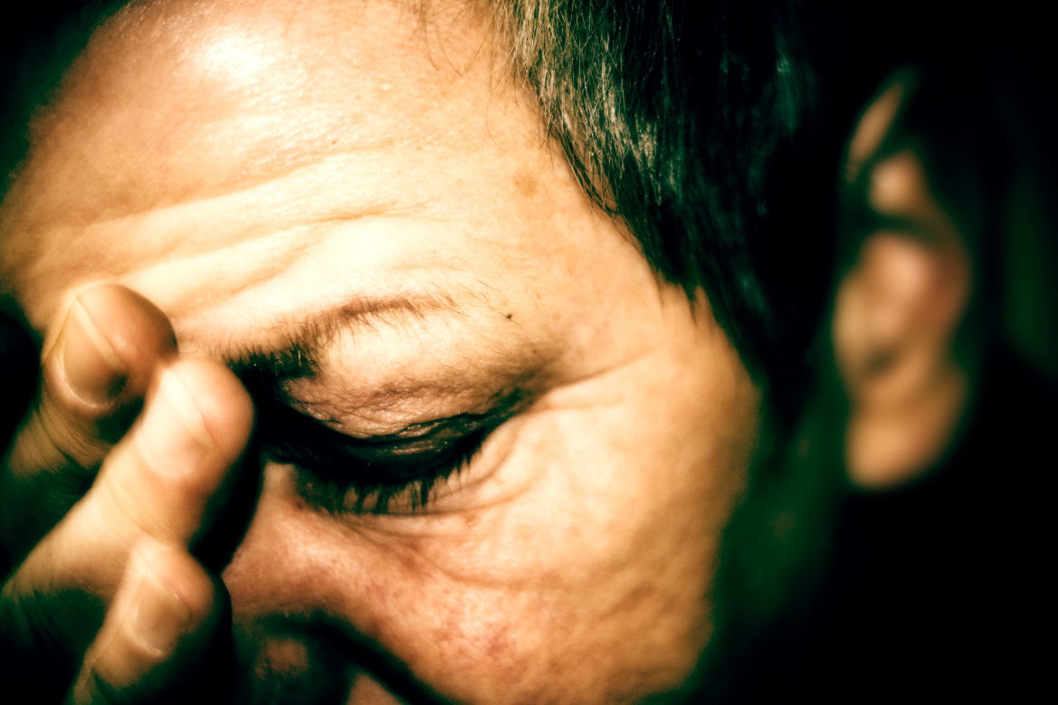
Is it wrong to use Placebos for pain?
Consider a person in Chronic Pain – Incurable pain that exists in daily life.
Notes:
So, should placebos be prescribed for those in pain? This is most effective and usually done when the patient has no idea they are receiving a fake treatment. You have to weigh up whether the deception is worth the chance of being able to reduce pain, as there will be consequences.
Somebody who finds they have been deceived, even if the treatment has worked can feel that they cannot trust the healthcare system. After all healthcare decisions are in the hands of the patient, who must be fully aware of the treatment they are receiving and have the opportunity to reject it. Losing trust in the healthcare system can set a negative mindset to treatment and can even lead to the nocebo effect, causing a worsening of symptoms. Also patients may question their mental stability. Whether they spent a large period of their lives imagining they were in pain where the whole thing was in their head. In this sense, deception is very unethical and can lead to many more negative outcomes.
However, among some of the interviews I conducted, I found people are in such bad positions with pain affecting every aspect of daily life they would give anything to have an improvement in pain. It also raises a paradoxical question of whether it would be unethical to NOT prescribe a placebo for somebody in pain.

Slide 9
Effectiveness
Efficacy in around ~40-60% population (+/-)
Used as a last resort
Can be administered without deception

Slide 10
Reflection
WWW – Sources, Primary Research
EBI – Experiment, GSK

