Slide 1
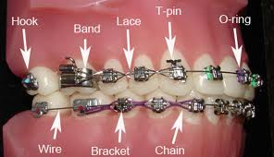
How significant have been the developments in dental braces since the 1960’s?
Candidate 3
Notes:
I am sure you are all as giddy with excitement now as I was when I first embarked on researching this fascinating question.
So, what actually made me decide to write a 5,000 word report on braces and invest such a great deal of time into it. Well, it was a multifactorial reason. First, it greatly satisfied my interest into a future career of orthodontics and dentistry, and secondly, wearing braces myself, I was very keen to gain a greater understanding and appreciation of the braces I currently wear.

Slide 2
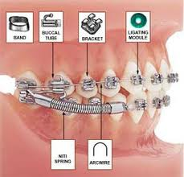
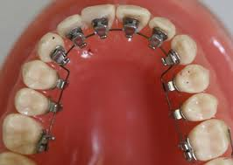
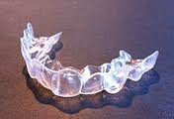
The three developments
Nitinol archwires in braces
Lingual Braces
Invisalign
Notes:
I decided to focus on only three developments in braces since the 1960’s, as the restrictions on the word limit prevented me from including further braces with the same degree of analysis that I would have wanted to do. These three developments are Nitinol archwires, Lingual Braces and Invisalign.
In order to come to a valid conclusion to my question, I will assess and analyse the developments in dental braces by evaluating the benefits and disadvantages of the developments in comparison to the formerly common, conventional braces which used stainless steel as the archwire. I will further consider various other factors to come to a holistic understanding as to how significant the developments in dental braces have actually been.
As can be seen in the two braces to the right, much of the advancements have focused on improving the cosmetic appeal of braces.

Slide 3
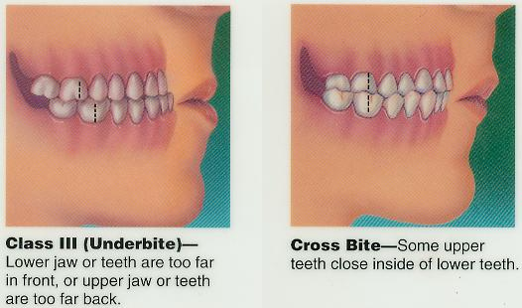
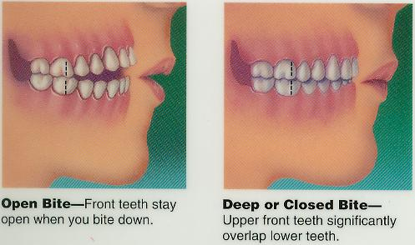
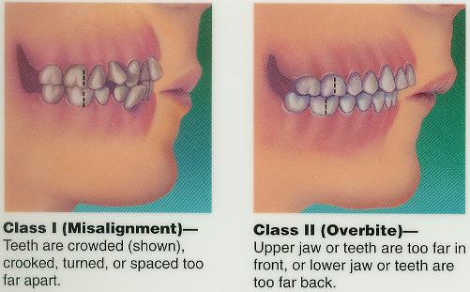
What’s the Point…?
To correct malocclusions—Improper bites
Notes:
So, what’s the point of braces?
Braces are designed to correct the alignment of teeth by applying a steady force upon them. These malocclusions, the term for improper bites, include misalignments, underbites, crossbites etc. Braces can be used to correct the positions of the teeth for health reasons as improper bites can lead to tooth decay, gum disease and wearing of the enamel, the generally white, visible layer of the tooth. However, braces are frequently being used by adults and children alike in a bid to gain ‘The Perfect Smile’ in a growing self-conscious society. This medical vs. cosmetic needs has resulted in a flurry of developments.
Conventional braces work by having metal brackets being glued onto each tooth, and then a wire, called the archwire, being passed through the brackets. The wire is tightened and this results in it exerting a force upon the teeth to move them to the correct position.

Slide 4
Nitinol Archwire
Shape Memory Alloy
Made of Nickel and Titanium in almost equal amounts
Nitinol archwires—Don’t need retightening
Stainless steel—Do need retightening.
Notes:
The archwire used to commonly be made of stainless steel and these worked through the orthodontist tightening the wire continuously to apply a pressure upon the teeth to move them.
However, the development of Nitinol archwires brought a significant development. Nitinol, made up of Nickel and Titanium equally is a shape memory alloy. This meant that Nitinol, upon heating through the mouth’s warmer temperature, could return to a pre-determined position of its own accord, and provide a great deal of force in the process. This meant that Nitinol archwires did not need retightening as they would continuously try to move back to their set position, thereby pulling the teeth into the correct position whereas stainless steel archwires require continuous retightening by the orthodontist.
This brings with it many advantages.

Slide 5
Benefits
Fewer appointments need to be made for the patient
Reduced pain
Stainless steel can form ‘kinks’
Notes:
As no retightening is needed for Nitinol archwires, fewer appointments are needed with the orthodontist. This results in reduced pain for the patient. Moreover, it provides significant economic benefits for the dental surgery. More time will be available for the orthodontist to see other patients, resulting in a greater number of patients being seen, and consequently increased efficiency and profits for the practice. Fewer appointments are additionally beneficial for the patient as less time off work is needed to be taken.
Moreover, stainless steel can form ‘kinks’ when the wire is bent around the teeth. This results in the wire no longer producing a force on the teeth and so has to be replaced. A Nitinol archwire is in contrast, far more ‘kink’ resistant, and can be continuously bent without producing ‘kinks’ in its structure.
As a result, most dental archwires are now made from Nitinol.

Slide 6
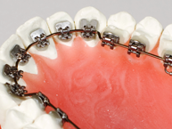
Lingual Braces
Notes:
Lingual braces are braces which are fixed on the side of the teeth closest to the tongue, ie the inside of the teeth, making them practically invisible. Parts of the brace can still be seen however, if looked at very closely.

Slide 7
Benefits and Disadvantages
Discreet
Few people are aware of it
Specialist training
Less significant
Notes:
Lingual braces provide immense social benefits, as a method of correcting misalignments of the teeth without being seen. They therefore provide a far greater cosmetic appeal.
However, there is a significant limitation to this development in that few people are aware of it. In a survey commissioned by the British Lingual Orthodontic Society, 72% of people in England did not know about lingual braces. Therefore, it’s significance is undermined. However, it should be stressed that this figure is including those who do not need braces, the majority of patients who actually need braces will generally be informed of the different braces that are available such as lingual braces.
Moreover, the orthodontist requires specialist training to administer braces which is generally costly and as a result relatively few dental surgeries provide lingual braces.
Consequently, it can be deduced that although lingual braces are a significant cosmetic development, it is less significant than the creation of Nitinol archwires.

Slide 8
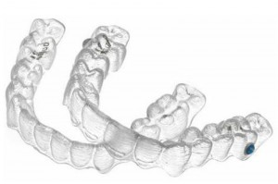
Invisalign
Clear, plastic aligners
Notes:
Invisalign treatment involves wearing a series of clear, plastic aligners that are replaced every two weeks. These aligners can easily be taken off or put on by the patient at will. However, they need to remain at least 20-22 hours per day in order to have a sufficient effect upon the teeth.

Slide 9
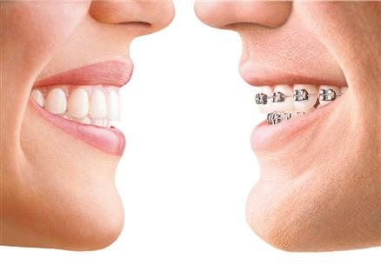
Benefits and Disadvantages
Can be removed
Less aggravation of gums
and lips
Invisible
Less effective at treating certain malocclusions
Notes:
The ability to remove the aligners provides a great deal of benefits. It allows greater oral hygiene as they can be removed before the brushing of the teeth, and thus result in less tooth decay compared to traditional braces. They also do not affect the diet of the patient as they can be removed before eating, thus providing less discomfort for the patient, as well as allowing the individual to consume normally prohibited foods such as chewing gum. They also aggravate the gums and lips less than conventional braces.
Ultimately, the greatest benefit of Invisalign is its aesthetic appeal. It is practically invisible and so the aligners are far more popular than their conventional counterparts.
Nevertheless, a notable weakness with Invisalign is that it is less effective at treating certain malocclusions compared to conventional braces.

Slide 10
Why Braces fail to be significant?
LEDC’S where oral
health is of minor importance
Psychological stress
Notes:
Ultimately, it needs to be understood that these developments are only significant in areas where they can actually be used. In Low Economically Developed Countries, where oral health is of minor importance due to the lack of the other necessities of life such as food, as well as the inability to afford such treatments render braces to be insignificant in those parts of the world.
Moreover, as I am sure you are aware, that even braces using Nitinol archwire can cause can cause psychological stress for the patient due to their likeness to conventional braces. Braces can result in bullying for the teenager who wears them and as a result more needs to be done in order to combat this and provide further improvements for the patients.

Slide 11
Clinical Problems with Braces
Notes:
Dental braces are far from perfect. Despite the developments, there are still many clinical instances where braces have failed to function and have caused new additional problems, and misalignments in the teeth. One example is a patient in the USA, who required a slight movement of his upper right teeth into the correct position. This procedure was to last 6 months. However, the braces attached resulted in all his upper teeth shifting to the left, thereby worsening his malocclusion and delaying his treatment until 3 years. This indicates that the developments have not yet reached a stage to be void of problems.

Slide 12
Conclusion
Notes:
In conclusion, it becomes clear that the developments have been highly significant due to their benefits but by no means can it be said that they have perfected dental braces. Indeed, it should be stressed that the developments are only significant to those who are either in need of or who administer braces, and who also have the capacity to acquire braces.
Nevertheless, the developments have resulted in many people to use braces who would otherwise not have done so. Despite the disadvantages limiting the impact of the developments, the vast benefits to a wide variety of people have rendered them significant to a great extent.

Slide 13
Reflection
Organisation
Management
Sources
Notes:
Reflecting on my project as a whole, I feel my greatest strengths were in my planning, organisation and management of this project. I had set myself early deadlines, and by keeping to them, I ensured I wasn’t overburdened with work, and greatly reduced any stress or pressure to complete the project and meet the school deadlines. I had planned very thoroughly, and it was very useful for me in providing both clarity in my research and a clear structure in my report.
Due to the specific nature of my topic, there were no available books on it, and as a result I had to look for other sources of information. Nevertheless, I ensured I used reputable sources such as from journals and articles. One weakness in my project, was that I was unable to meet with the professors of dental universities as I had initially desired due to their busy schedule. However, I feel that overall my project was a great success, and am very happy with how I have conducted myself in completing it.
Thank you all for listening, please feel free to ask any questions.

