Slide 1
Should an allergic reaction like Solar Urticaria be given the same recognition as a terminal disease?

Slide 2
History
King menses
Britannicus
Clemmens von pirquet
Allos
Ergon

Slide 3
What is an allergy
Hypersensitivity
Harmful immune response
Auto-immune disease
Anaphylaxis

Slide 4
How allergies work
Mast cells
Histamine
Leukotriene

Slide 5
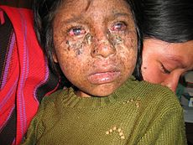
Solar urticaria
What is it
Causes hive like symptoms
Hives very common
Xeroderma pigmentosum

Slide 6
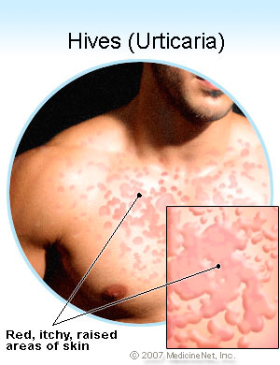
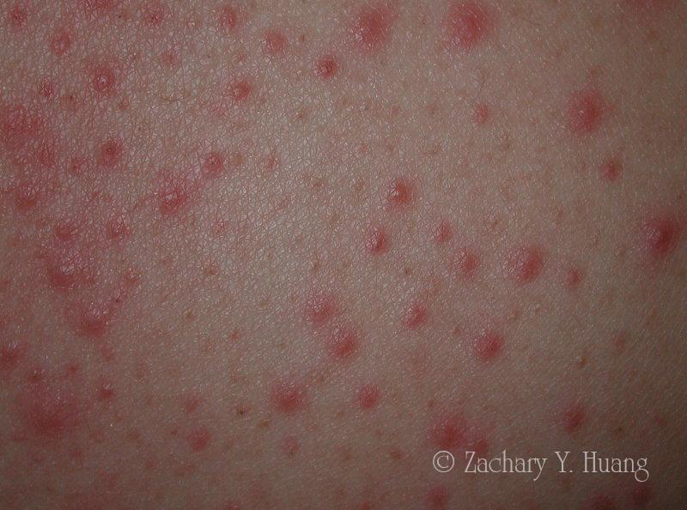
Causes-Environmental or genetics
Sun
Temperature
Causes hives

Slide 7
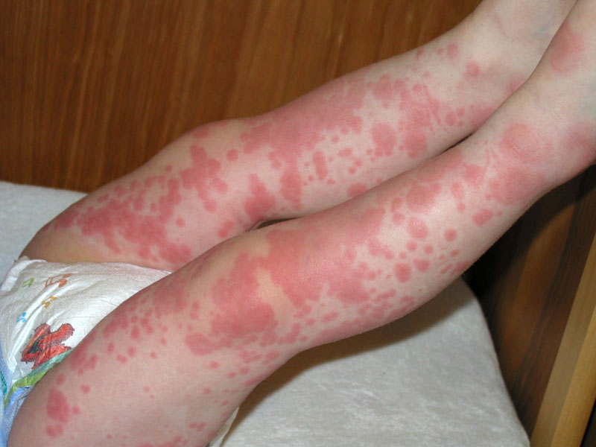

Slide 8
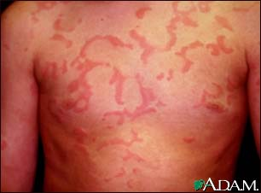

Slide 9
Treatments
No cures but treatments
Antihistamine
Topical steroids
Desensitisation phototherapy
CBT
Sunscreen 30 SPF
Prevention

Slide 11
Side Effects

Slide 12
Antihistamine
Drowsiness
Impaired thinking
Dry mouth
Dizziness
Constipation
Blurred vision
An inability to fully empty the bladder (urinary retention)

Slide 13
Topical steroids
Burning or stinging of the skin
Thinning of the skin
Acne or worsening of existing acne
Excessive hair growth on the area of skin being treated
Stretch marks

Slide 14
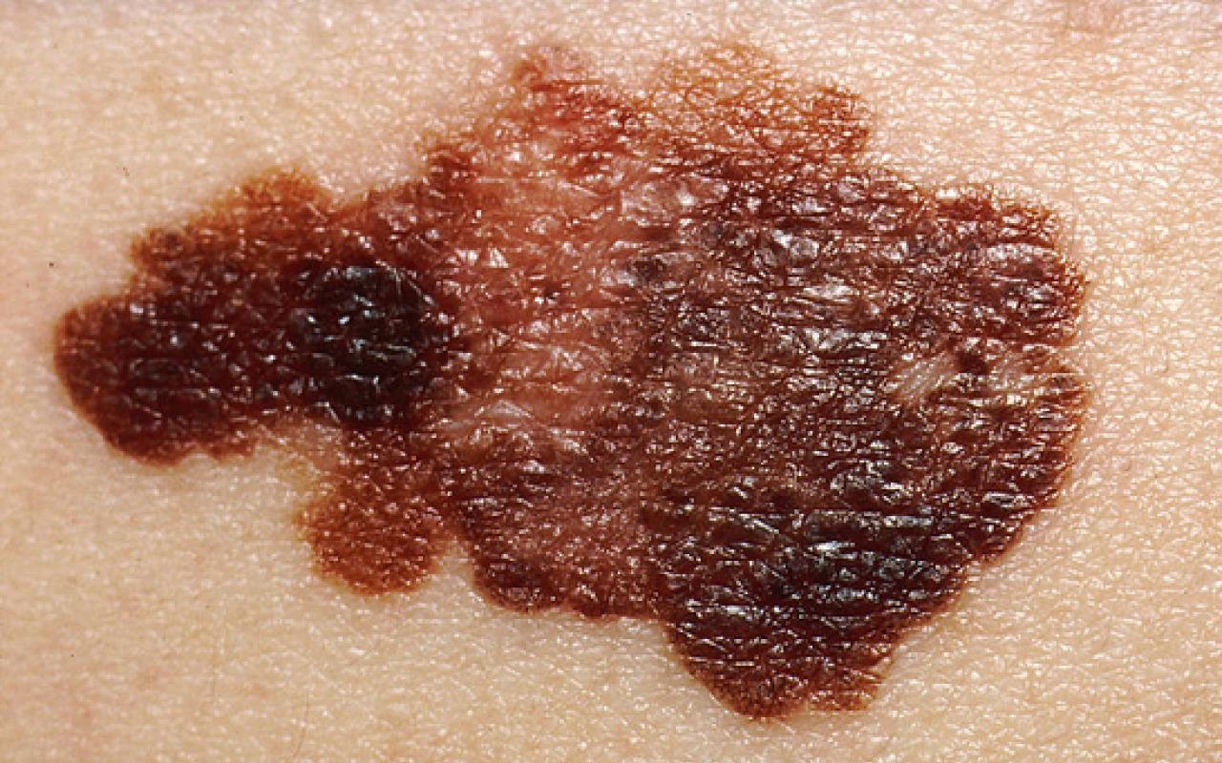
Desensitisation phototherapy
Skin cancer

Slide 15
Psychological impacts
Depression
Loss of Confidence
Bullying
Ben Ainsle - ‘Rudolph’

Slide 16
Allergies are on the rise

Slide 17
Why are allergies increasing
Pollution
Allergen exposure
Decrease in immunity

Slide 18
Should an allergic reaction like Solar Urticaria be given the same recognition as a terminal disease?
Affects are more than physical
Tackle factors, pollution and other factors
raise awareness in media and school
If not dealt with now future generations will suffer

Slide 19
How I came to create this question
5 most bizaare allergies
Rarest
Aqugenic urticaria
Aquagenic and solar
Finally current title

