Slide 1
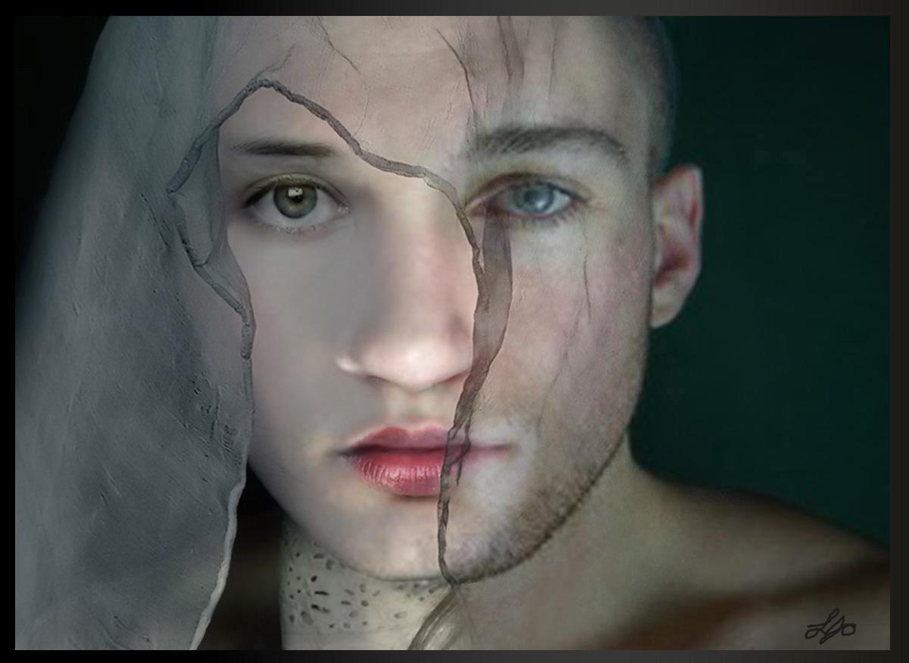
Gender Identity Disorder

Slide 2
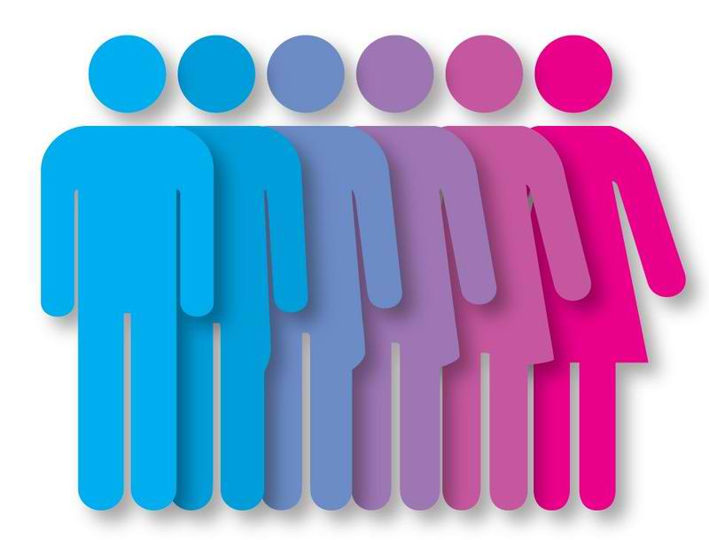
Trans woman- someone who is biologically male but identifies themselves with a female
Trans man- someone who is biologically female but identifies themselves with a male

Slide 3
Woman

Slide 4
Trans man

Slide 5
Trans man

Slide 6
Trans woman

Slide 7
To what extent is medical treatment being given to Gender Identity disorder sufferers?

Slide 8
What exactly is GID?.
Gender Identity disorder is the formal diagnosis by psychologists and physicians for one feeling a mismatch between their anatomy and gender identity, in turn forcing them to identify more with the opposite sex

Slide 9
Key terms
Gender Dysphoria
Transgendered/transsexual person
Transvestite

Slide 10
So why-Biological?
Biological
Number of neurones
in the nucleus of
the anterior (front)
hypothalamus

Slide 11
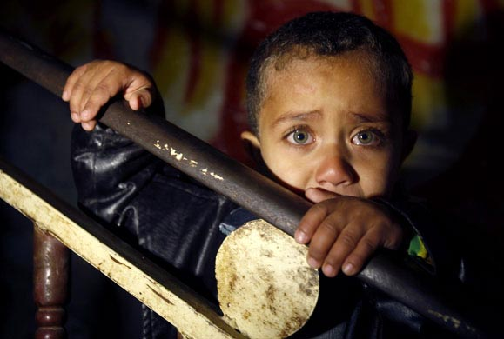
Or does it go beyond biology...
Psychological
Trauma

Slide 12
What are we providing for transgendered people?
Treatment offered in the UK:
Stage 1: Psychotherapy
Stage 2: Hormone therapy and ‘Real Life Experience’
Stage 3: Gender Reassignment surgery

Slide 13
Is it enough?
Challenges that prevent treatment from being improved:
Lack of awareness
Rarity of the disorder
Increase in GID sufferers
Time

Slide 14
To what extent is medical treatment being given to Gender Identity disorder sufferers?

Slide 15
The highs and lows....

